Slide 1



BUILDING MULTIPLE-CHOICE TESTING APP ON MOBILE DEVICES
Mentor : ThS. Ninh Khánh Chi
Doer : Đinh Hữu Đức

Slide 2
CONTENTS
Software overview
(1)
(3)
In troduction to the topic
(4)
App
(2)
Technology used

Slide 3

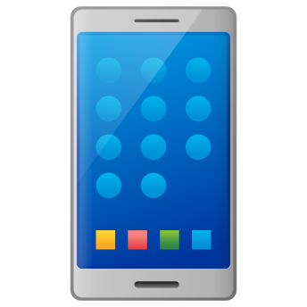

INTRODUCE
In recent years, multiple-choice exams have become very popular and are becoming more popular.
Along with the development of information technology is the birth of more and more handheld devices, smartphones.

Slide 4

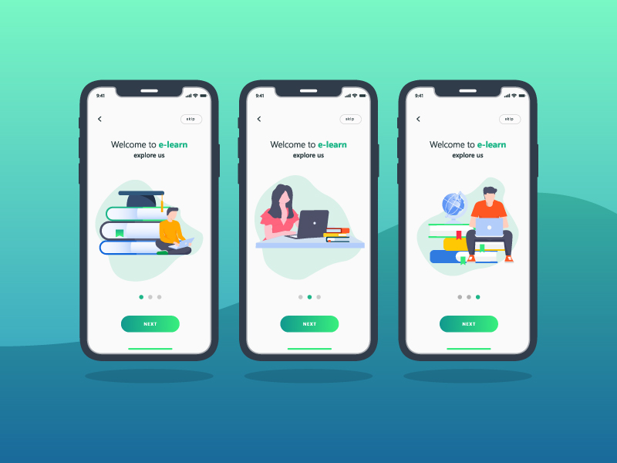

with the plan:
Build Menu interface, Multiple choice exam
Interface design allows handling of the main functions

Slide 5


Summary of the question
Check answers (unanswered)
Score yourself at the end of the time
Watch List
Review the theory
Account Management

Slide 6


TECHNOLOGY USED
Android Operating System
Java language

Slide 7
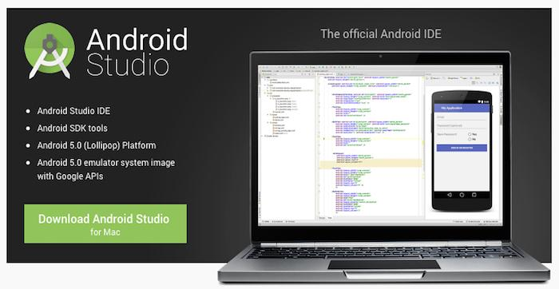
Android Studio software
Android Studio is an integrated development environment (IDE),…
Launched on May 16, 2013, at the Google I/O conference.
Notes:
Android Studio là IDE chính thức được sử dụng trong phát triển ứng dụng Android dựa trên IntelliJ IDEA. Chức năng chính của Android Studio là cung cấp các giao diện giúp người dùng có thể tạo các ứng dụng và xử lý các công cụ file phức tạp sau hậu trường.

Slide 8

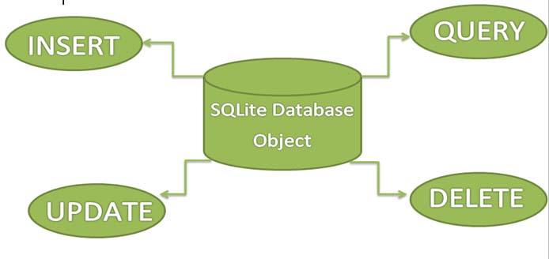
SQLite database.
SQLite is Mysql, PostgreSQL database management software…

Slide 9
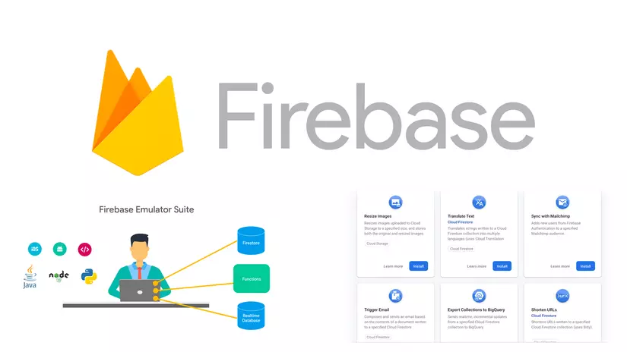
Firebase is a Google-owned platform that helps us develop web and mobile apps.

Slide 10

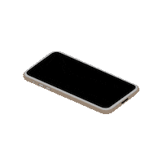
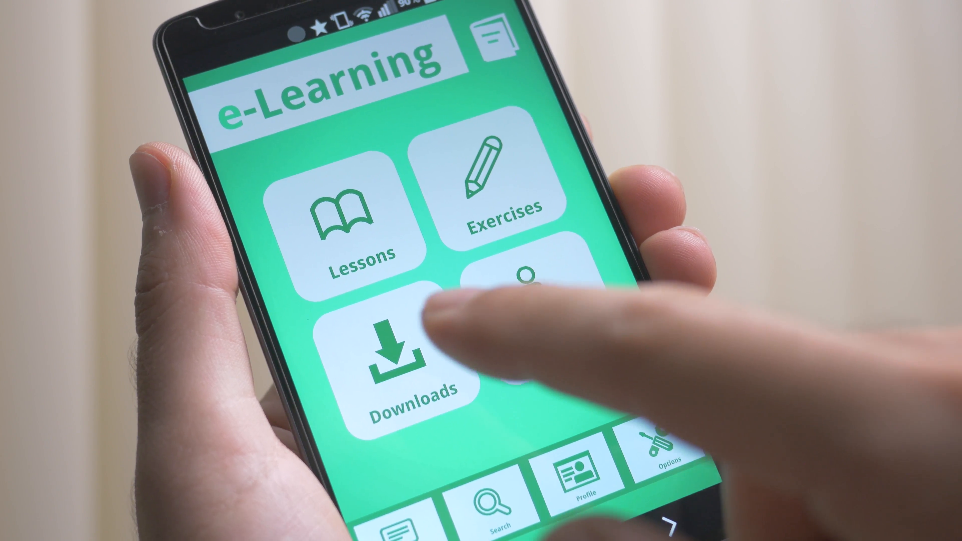
SOFTWARE OVERVIEW
The program includes exam questions for each subject along with time and scoring methods.
Help you add solid knowledge, and achieve high results in your academic record.

Slide 11

FUNCTION
Test management: Select the correct answer according to the countdown time and see the list of answered answers.
Score management: View previously saved work scores
Theory search: view theory, search theory by topic.
Login, Logout, User Management

Slide 12
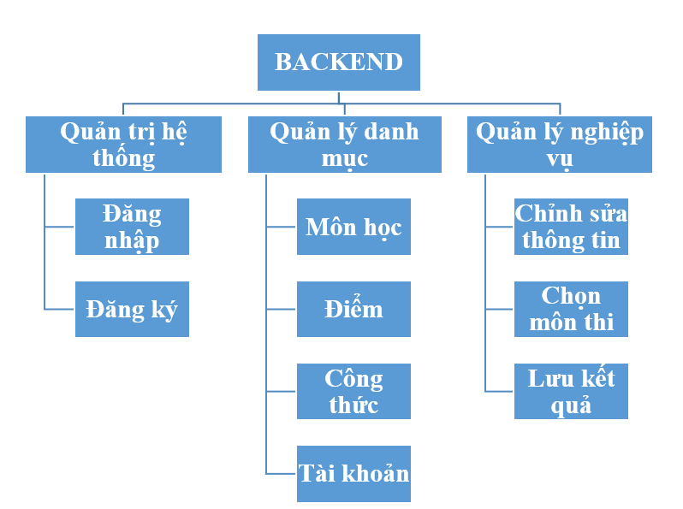
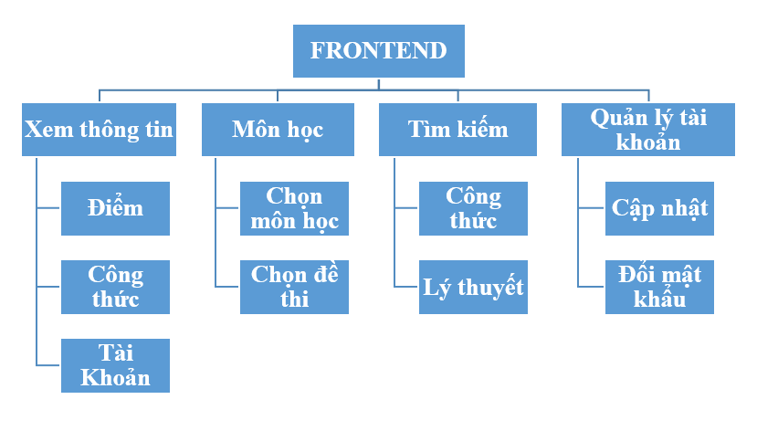
The Function Hierarchy Diagram

Slide 13
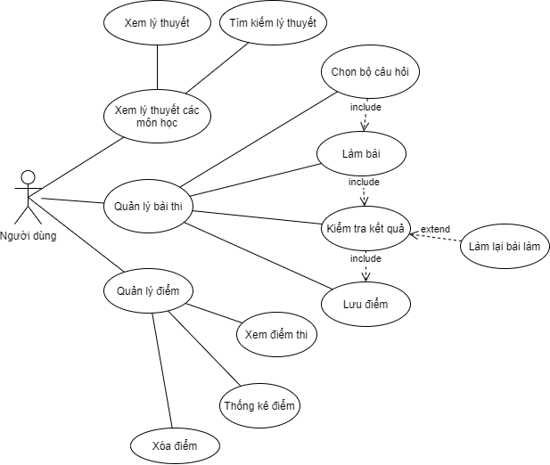
USE CASE Diagram

Slide 14
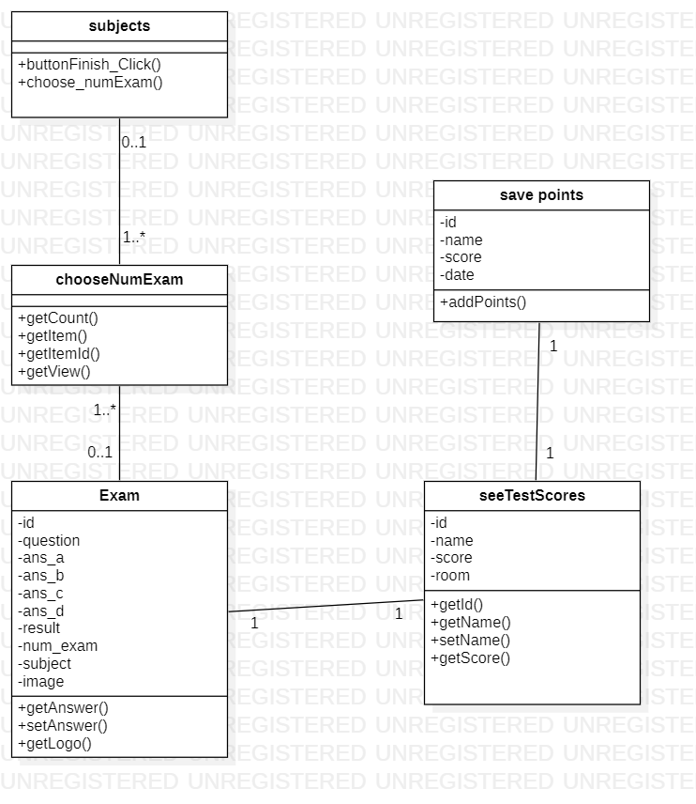

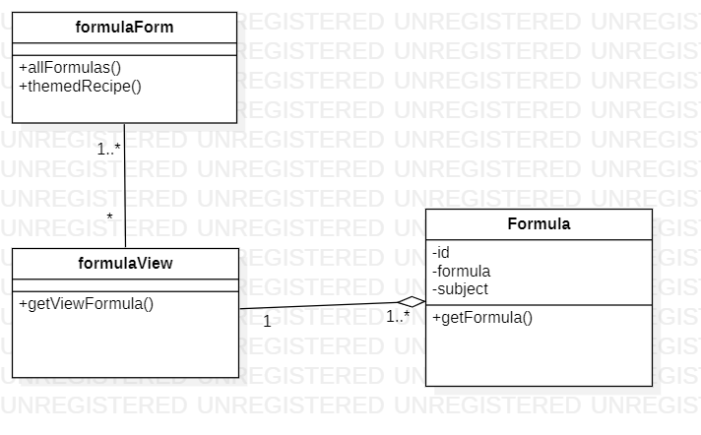
CLASS DIAGRAM

Slide 15
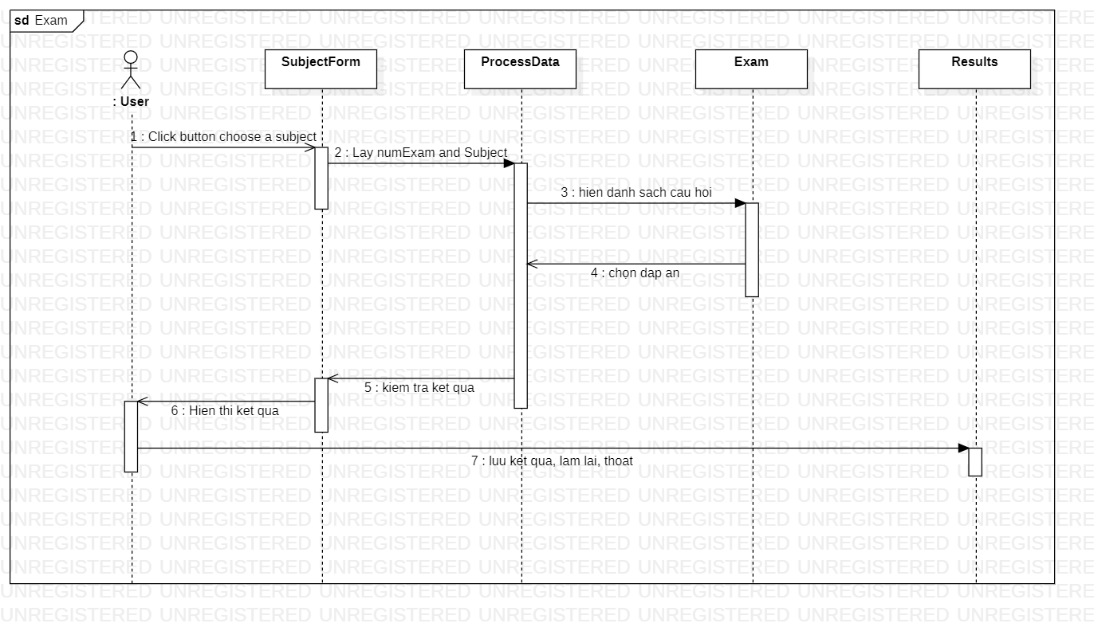
SEQUENCE DIAGRAM

Slide 16
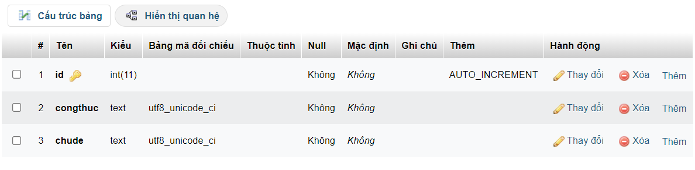
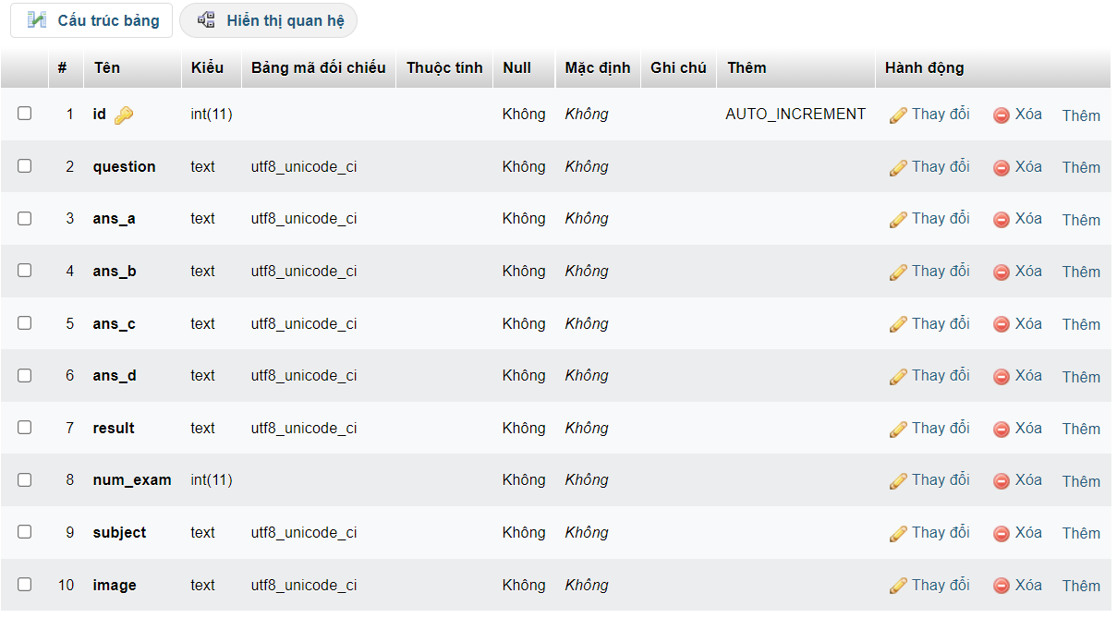
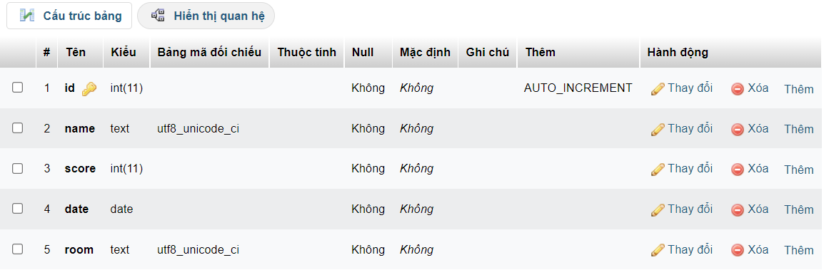
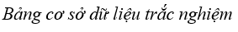
DATABASE TABLE

Slide 17
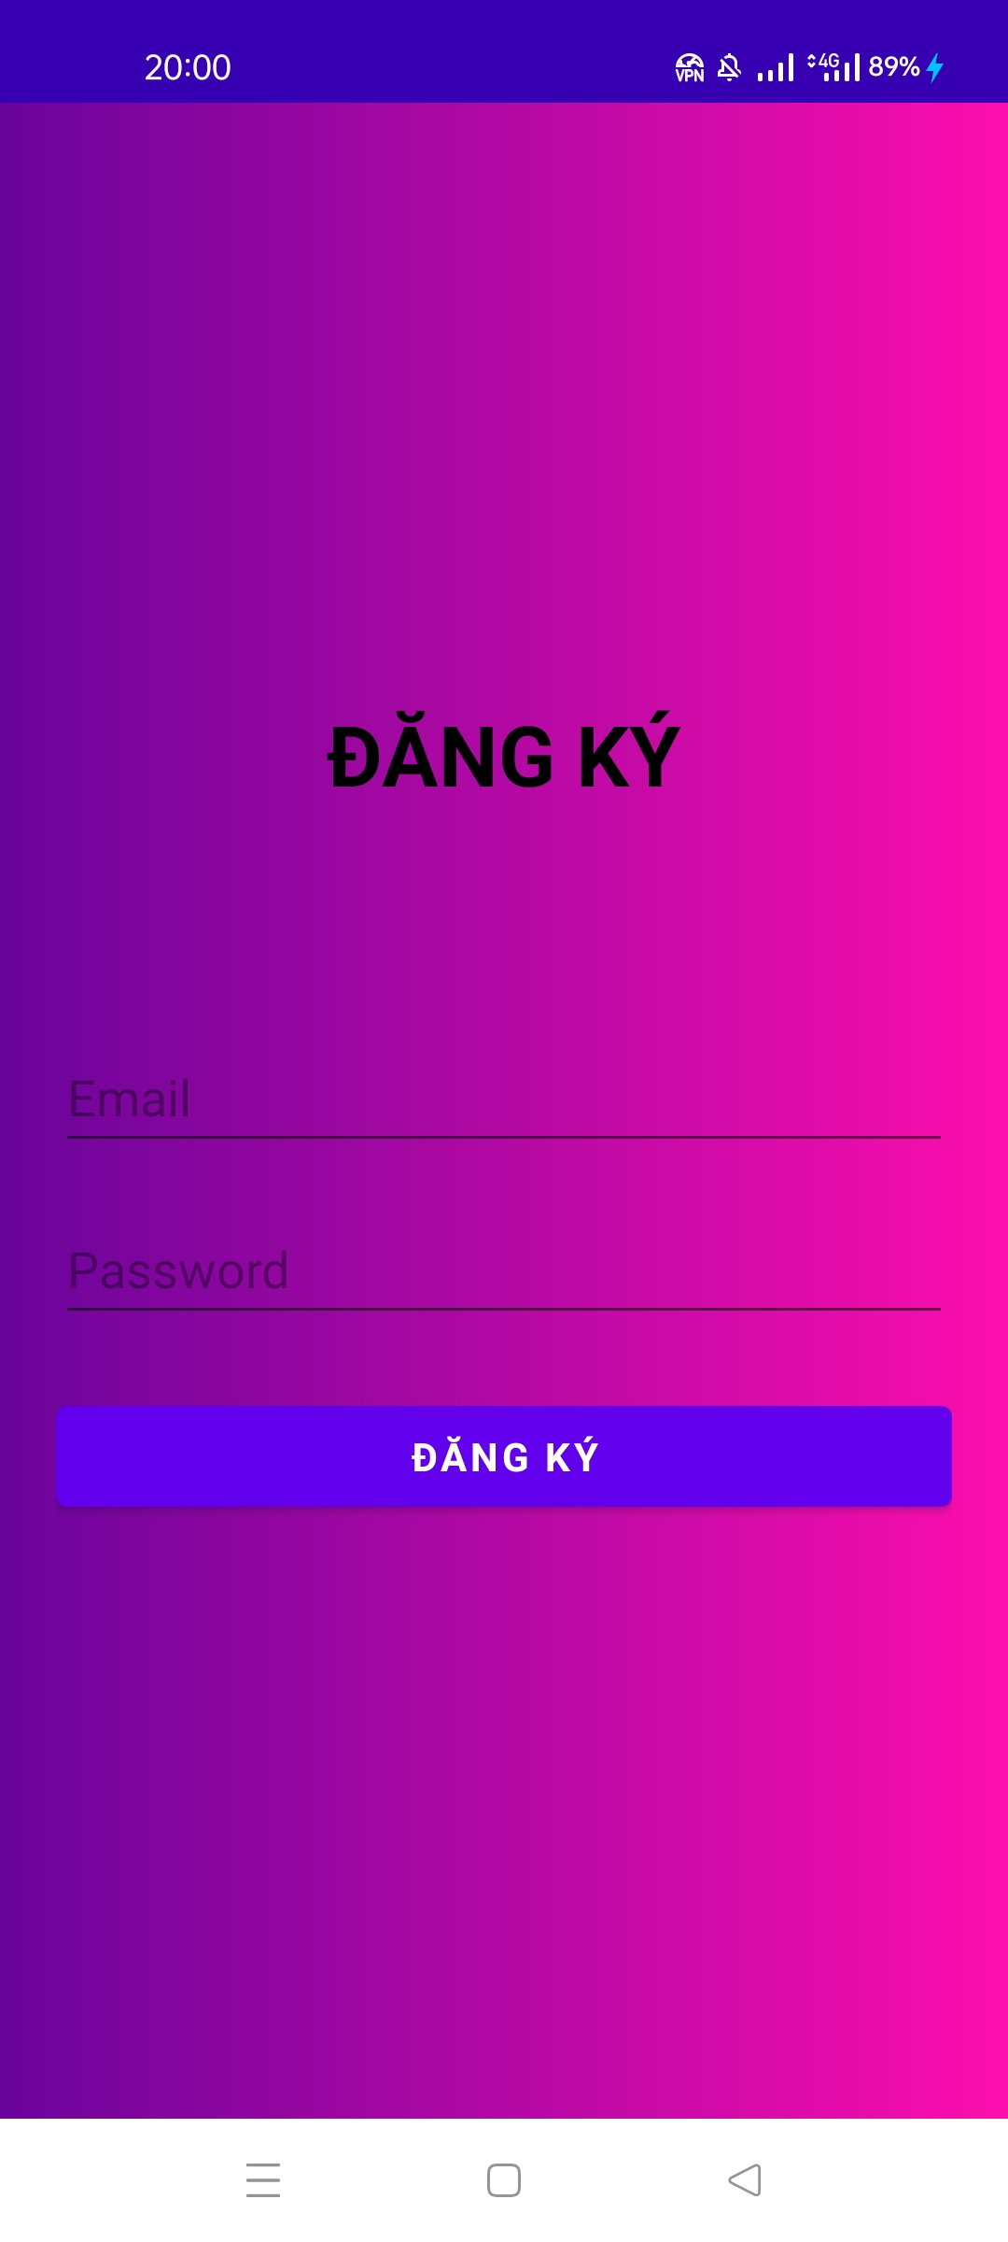
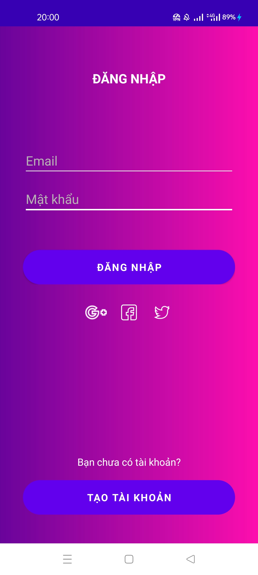
APP INTERFACE
login and registration interface

Slide 18
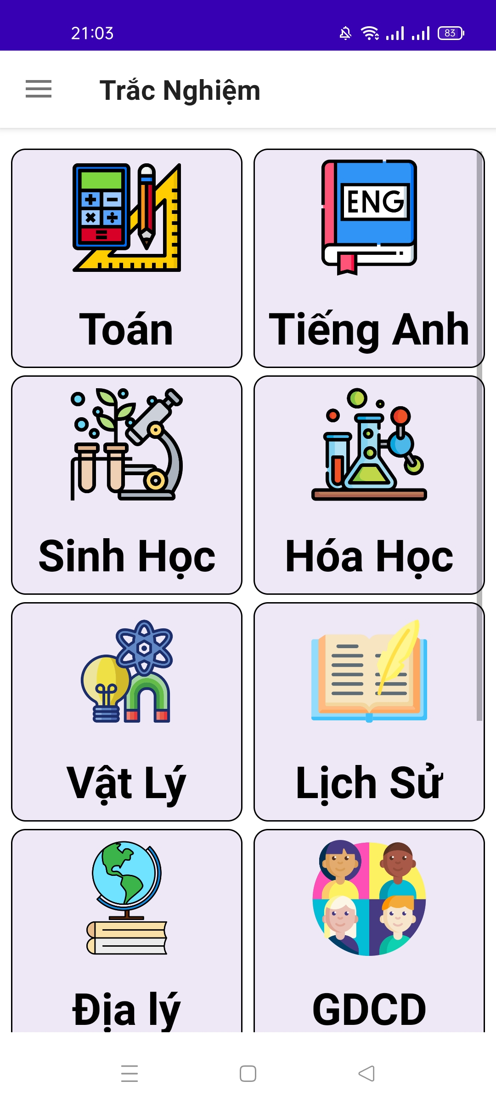
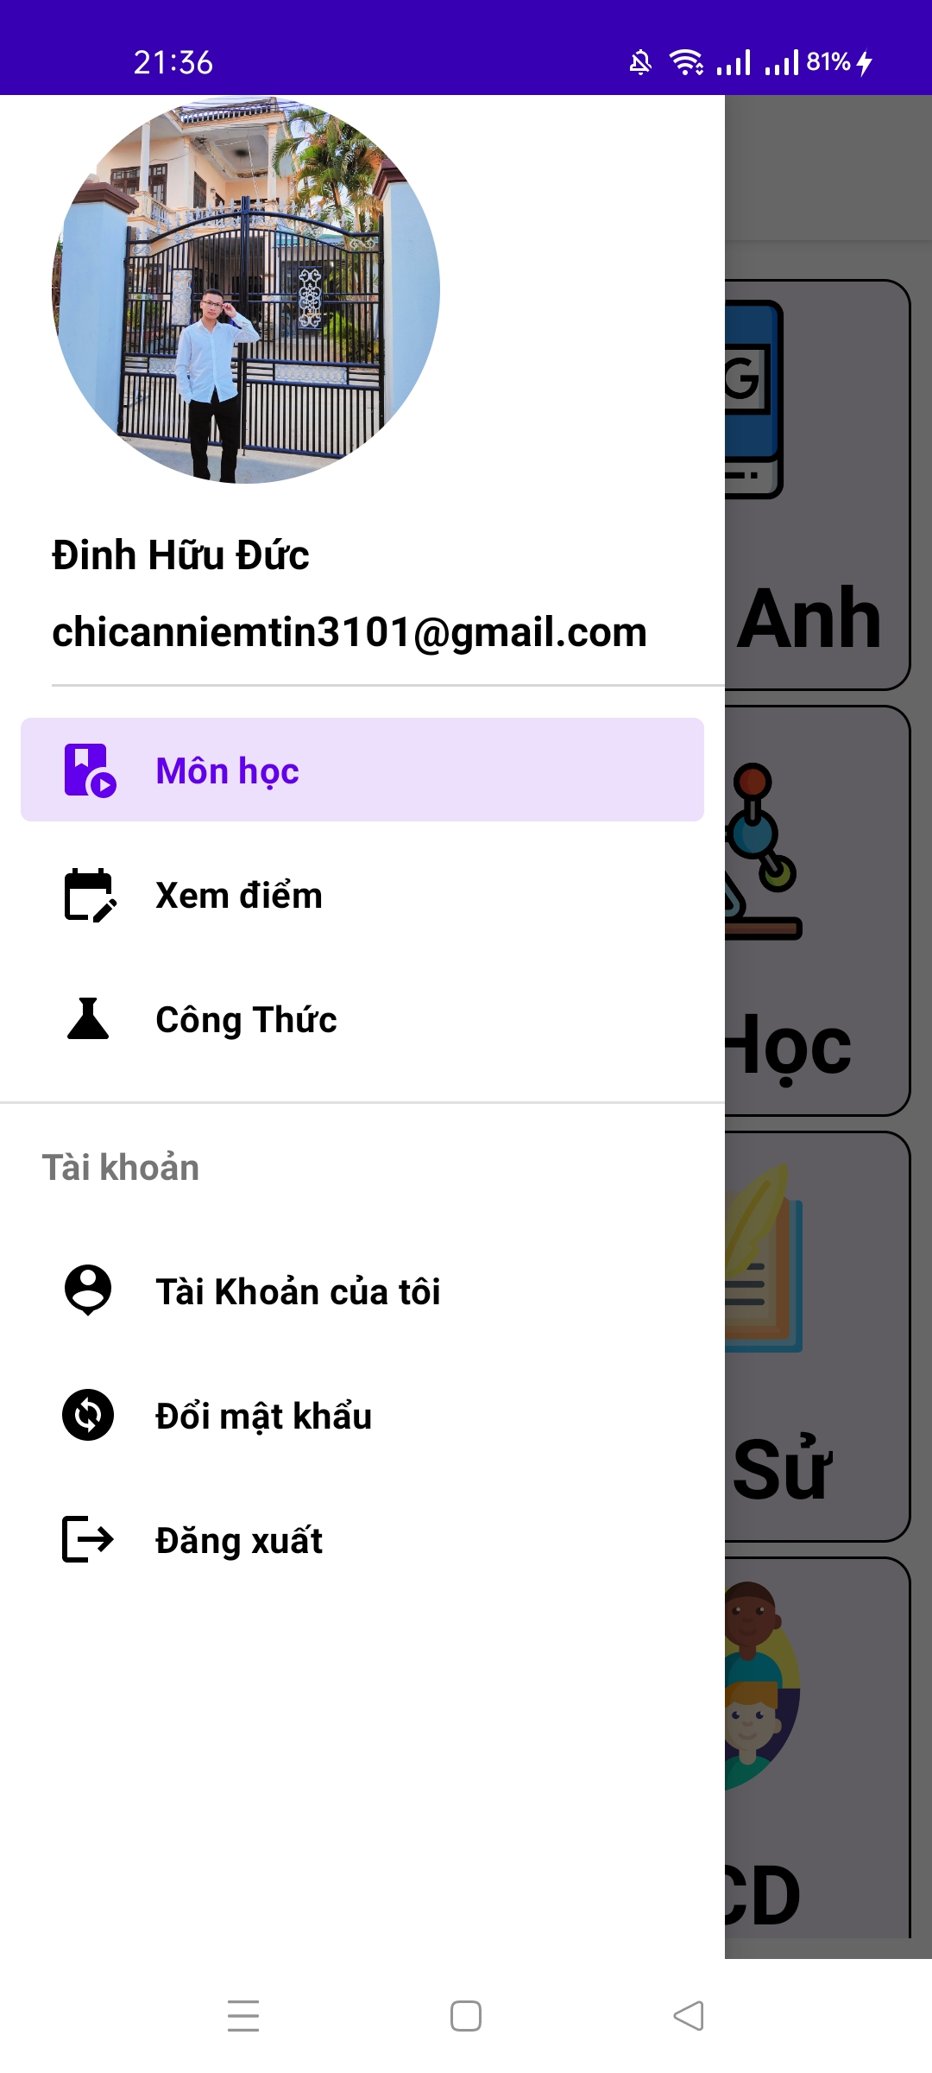

APP INTERFACE
Main screen interface

Slide 19
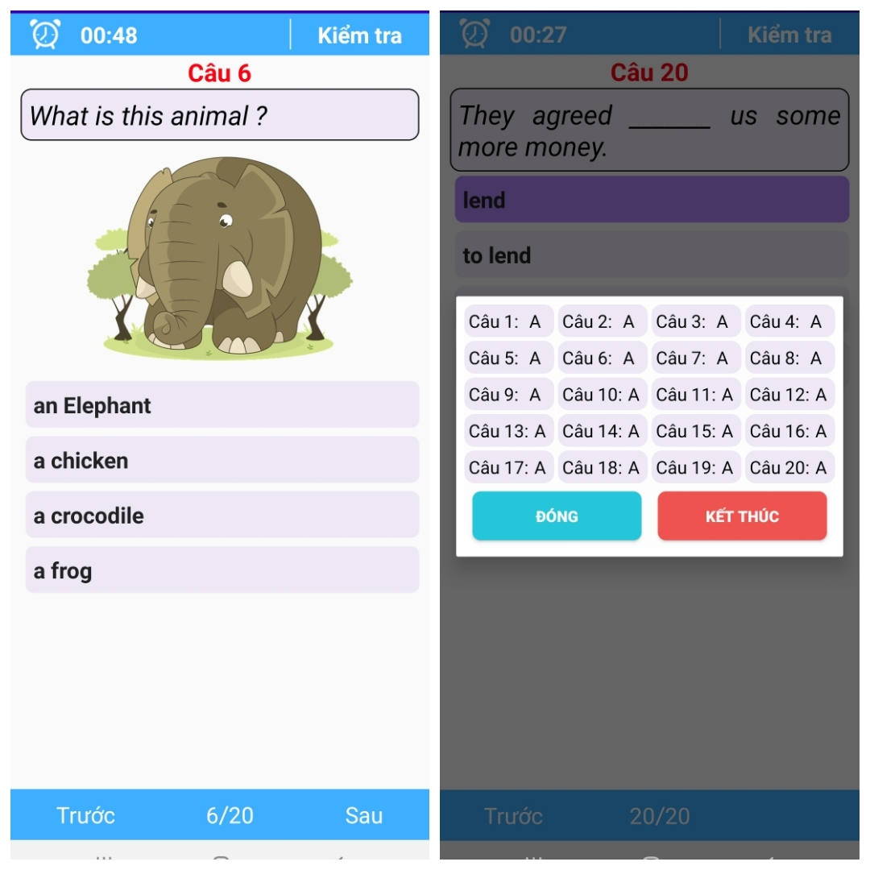
APP INTERFACE
Exam interface

Slide 20
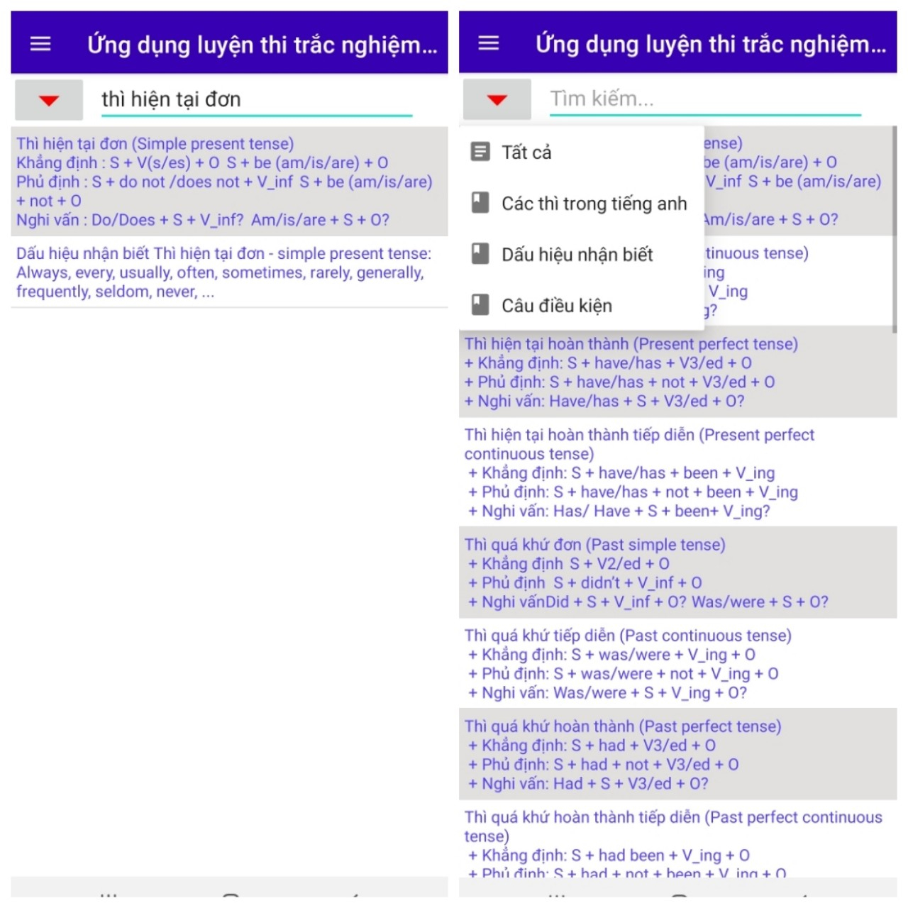
APP INTERFACE
Theory view interface

Slide 21
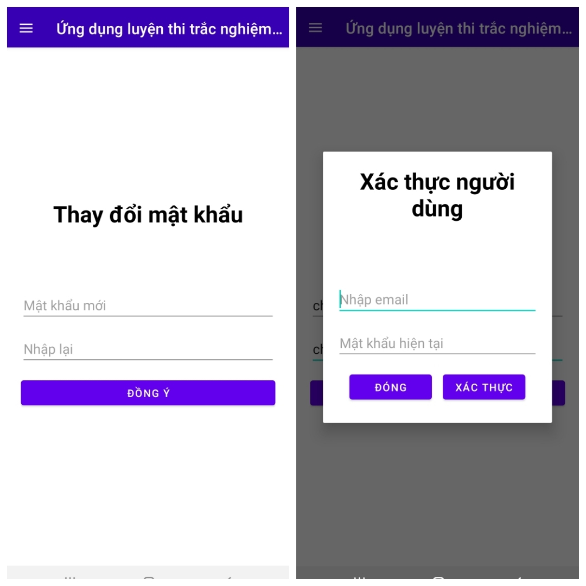
APP INTERFACE
Password change interface

Slide 22
For Listening

